Slide 1
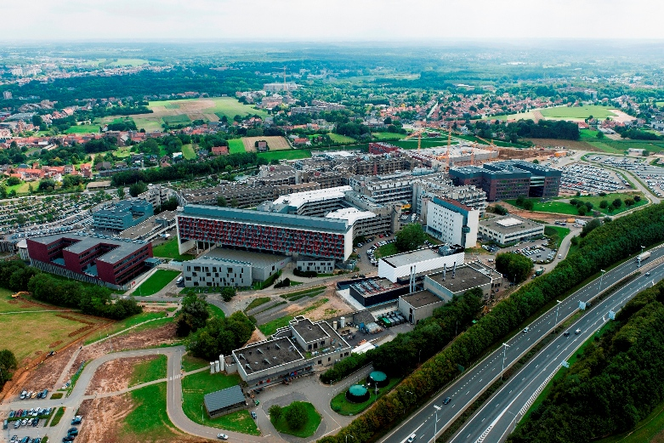
Liver Cancer
No Patient Left Behind, Optimising the European Response
Progress in treatment of HCC
11 oct 2022
DIGESTIVE ONCOLOGY
Jeroen Dekervel - MD PhD

Slide 2
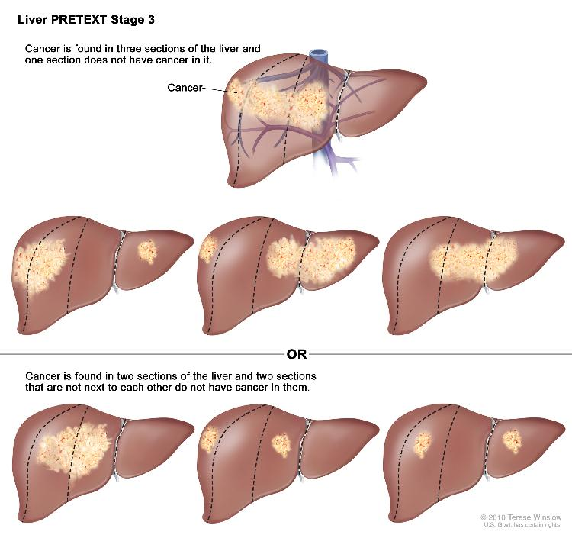
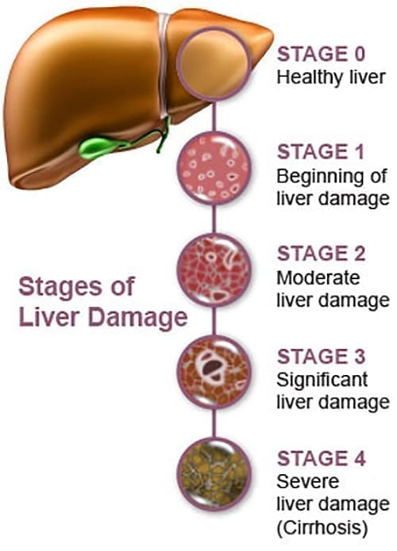

The Tumour
The Liver
The Patient

Slide 3
Reig et al. J Hep 2022

Slide 4
Llovet et al. Lancet 2003

Slide 5
Optimal treatment allocation
Potent systemic agents
Bringing expertise together

Slide 6
Optimal treatment allocation
Potent systemic agents
Bringing expertise together

Slide 7
Gao et al. Nat Rev Clin Oncol 2015

Slide 8
Gao et al. Nat Rev Clin Oncol 2015 – Sperandio et al. Annu Rev Med 2022

Slide 9
Optimal treatment allocation
Potent systemic agents
Bringing expertise together

Slide 10
Anti-PD-1
Nivolumab
Pembrolizumab
Anti-PD-L1
Atezolizumab
Durvalumab
Anti-CTLA-4
Ipilimumab
Tremelimumab

Slide 11
Faivre et al. J Hep 2020

Slide 12
Optimal treatment allocation
Potent systemic agents
Bringing expertise together

