Slide 1
A European registry for primary liver cancer?
Peter Jepsen, MD PhD
Department of Hepatology, Aarhus University Hospital, Aarhus, DENMARK
Policy & Public Health Committee, European Association for the Study of Liver diseases (EASL)

Slide 2
Reducing mortality from liver cancer
Most patients with liver cancer have liver cirrhosis
1: Better prevention of liver cirrhosis
2: Better screening for liver cancer
3: Better treatments of liver cancer
4: Dissemination of best practices: No patient left behind

Slide 3
Disseminating best practices
Goal: Every patient with liver cancer receives the best treatment
“The best treatment” depends on
Tumor characteristics
Cirrhosis severity
Performance status = ability to work, need to rest, daily activities
We need to collect data across Europe to ensure that all patients receive the same high quality of care
Additional benefits: transparency, more & better research

Slide 4
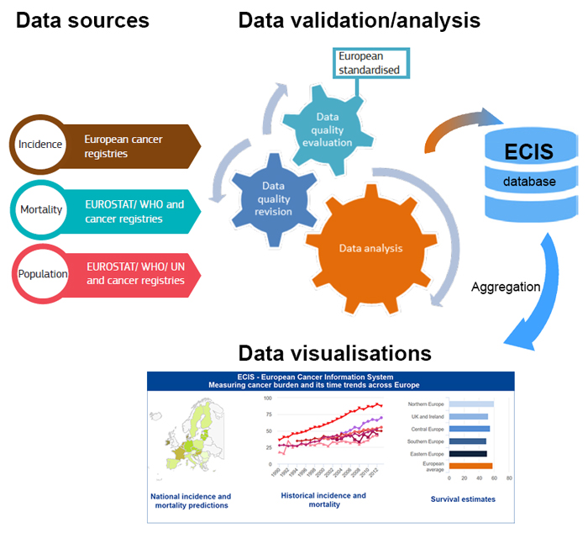
European Cancer Information System
Up-to-date cancer burden indicators across Europe
Geographical and temporal trends for major cancers
Incidence
Mortality
Survival data

Slide 5
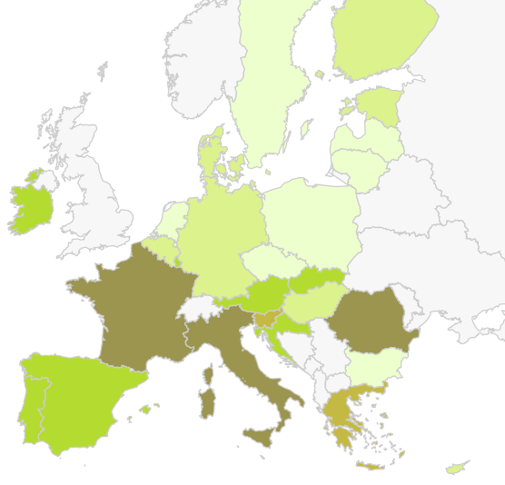
ECIS: Liver cancer incidence 2020

Slide 6
European Cancer Inequalities Registry
A flagship initiative of Europe’s Beating Cancer Plan
Identify inequalities due to
Age or sex
Socio-economic factors
Urban and rural areas
Guide investment and interventions at EU, national and regional levels

Slide 7
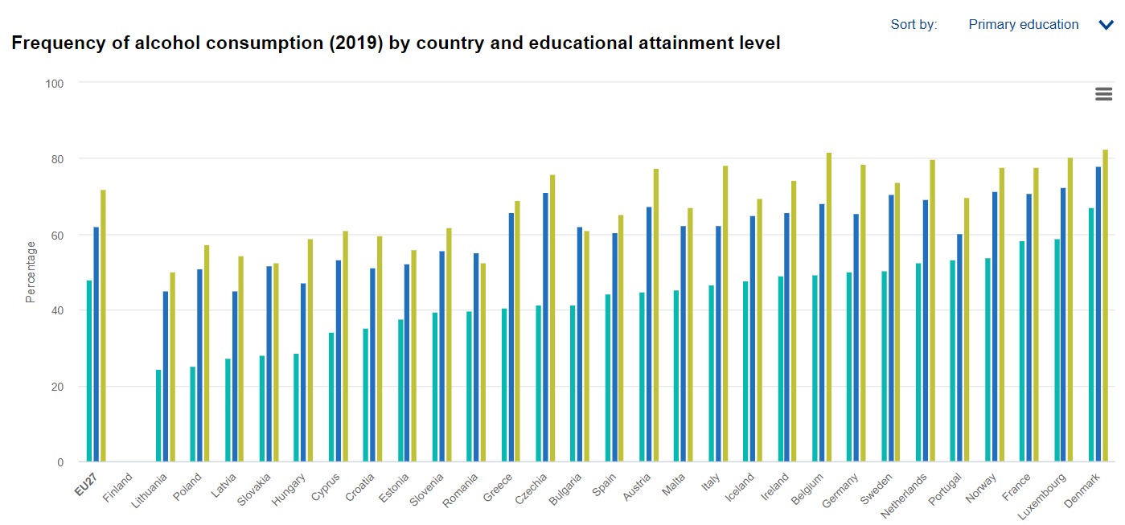
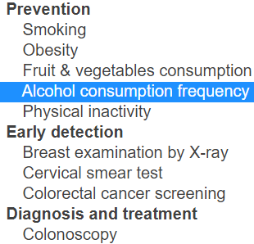

Slide 8
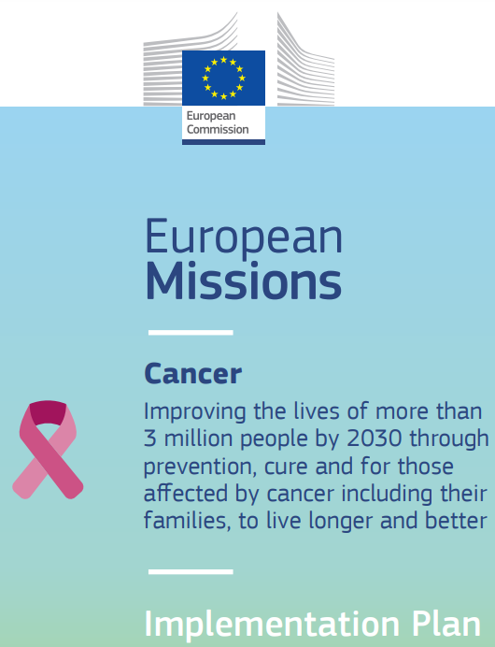
Collecting data across Europe
Many ongoing initiatives
Horizon Europe Mission on Cancer
Europe’s Beating Cancer Plan
Implementation plan from September 2021

Slide 9
New infrastructures
EU strategy 2020: “Shaping Europe’s Digital Future”
Digital solutions
European Health Data Space
Framework for the secure exchange of health data throughout the EU
UNCAN.eu (“UNderstand CANcer”)
“…combine research, patient health and any other data at an unprecedented scale”
“…new understanding gained from the analysis of this wealth of data could be applied to other diseases beyond cancer”

Slide 10
Mission on Cancer: objectives
Improve existing policies
Help update and expand cancer screening guidelines
Equitable access across four objectives
Understanding cancer
Prevention, including screening and early detection
Diagnosis and treatment
Quality of life

Slide 11
Objective 4: Quality of Life
Collect and analyze data on today’s unmet needs of cancer patients and survivors
Set up of the European Cancer Patient Digital Centre

Slide 13
European Cancer Patient Digital Centre
Goal: Network of patient-controlled health data infrastructures enabling the voluntary exchange of patients and survivors’ health data
“Towards the creation of a European Cancer Patient Digital Centre” : HORIZON-MISS-2022-CANCER-01-04
Zero proposals submitted (deadline was 7 September 2022) ☹
Notes:
https://ec.europa.eu/info/funding-tenders/opportunities/portal/screen/opportunities/topic-details/horizon-miss-2022-cancer-01-04

Slide 14
Summary (1 of 2)
Good existing platforms
European Cancer Information System
European Cancer Inequalities Registry
Many strong initiatives from the EU
Horizon Europe’s Mission on Cancer
Europe’s Beating Cancer Plan
Goals
Reduce inequalities
Promote best practices and patient involvement

Slide 15
Summary (2 of 2)
For liver cancer, we need additional information
Tumor characteristics
Cirrhosis severity
Performance status = ability to work, need to rest, daily activities
EU ensures legal and technical framework
EASL knows what information to collect
Supports European registries
Patient organizations and advocacy groups push!

Slide 16
Goal
All Europeans who have liver cancer - or are at high risk of getting liver cancer – receive the same high-quality healthcare

