Slide 1
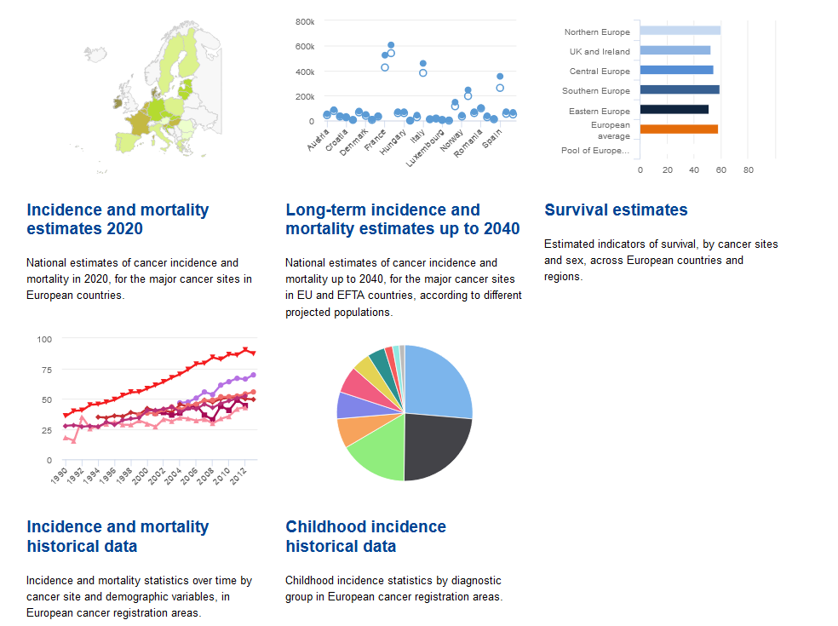
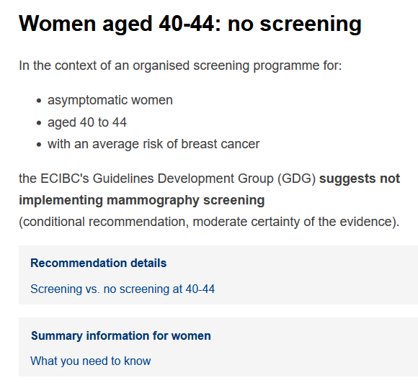
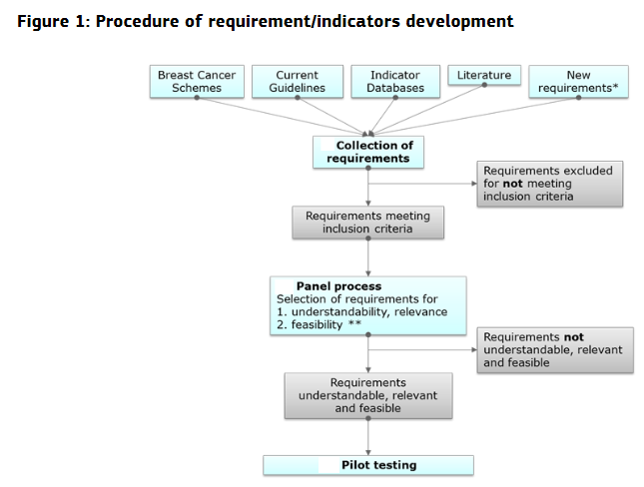
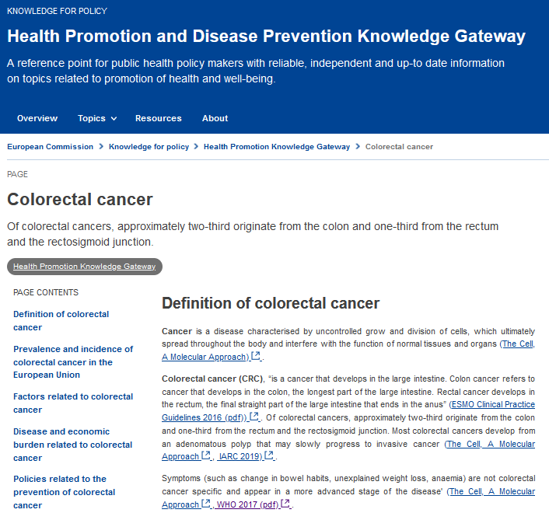
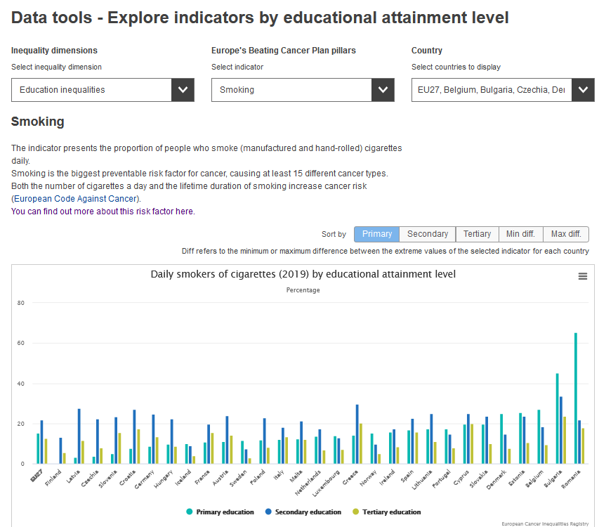
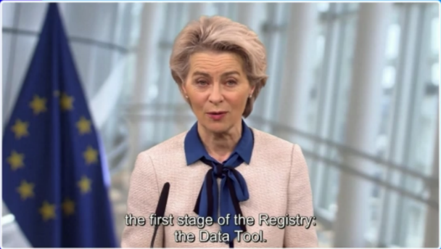
European Cancer Information System (ECIS)
EU guidelines and quality assurance schemes for cancer screening, diagnosis and care
Health Promotion
EU Platform on rare disease registration
EU Cancer Inequalities Registry (ECIR)

Slide 2
The European Commission Initiative on Colorectal Cancer (ECICC)
Aim: to improve the quality of colorectal cancer prevention, screening and care and contribute to reduce inequalities in accessing cancer services across Europe
Components:
Evidence-based guidelines’ recommendations on colorectal cancer prevention, screening and diagnosis
Quality assurance schemes covering the entire colorectal cancer care pathway
EU and beyond
Multidisciplinary working group: 15 members including patients’ representatives
Evidence-based recommendations, quality indicators and requirements
New approach: a methodological framework for a guideline-based quality assurance scheme development

Slide 3
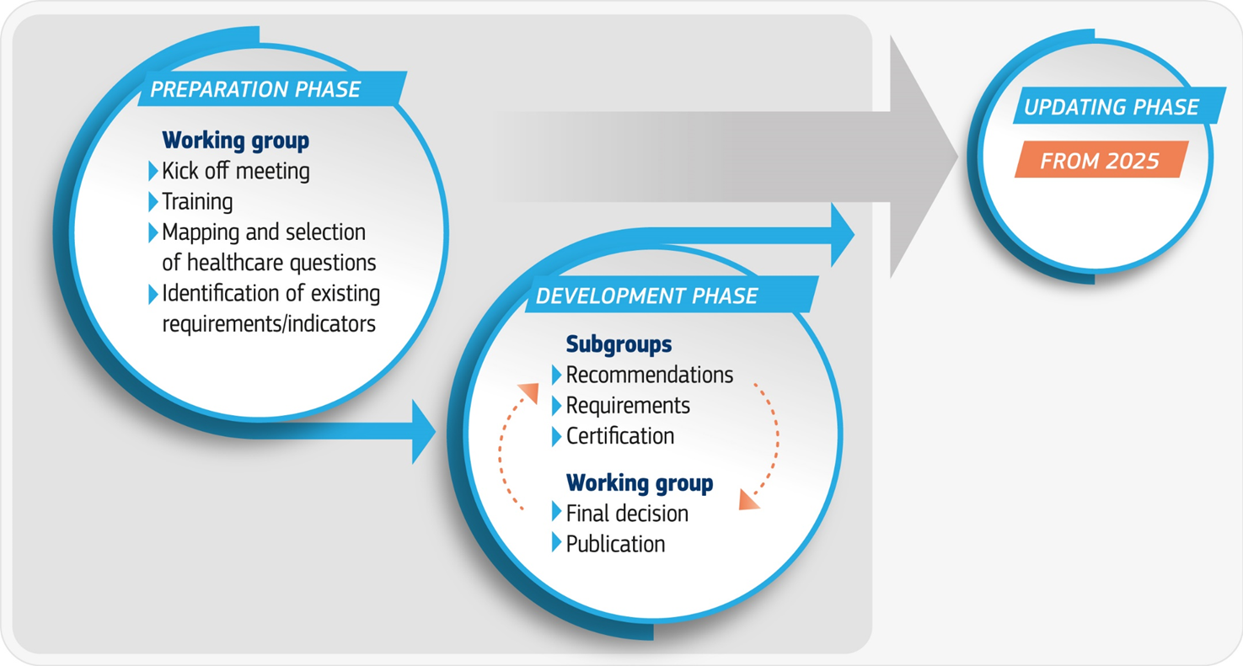
Roadmap

Slide 4
Status
4 subgroups already set up working on different outputs of the initiative (more to come)
50 healthcare questions on primary prevention and screening prioritised to be included in the European colorectal cancer guidelines
Stakeholders consultation on prioritization of additional healthcare questions to be published by the end of 2022
Certification framework finalised by January 2023
First set of recommendations (4 to 6) on prevention and screening finalised by the first half of 2023
60 experts included in the ECICC expert pool. Open call for experts available on our website: https://healthcare-quality.jrc.ec.europa.eu/ecicc/open-calls/call-for-expression-of-interest

