Slide 1

Precision medicine in Colorectal Cancer in the Youth. Risk factors and population in risk.
Dr. JOSÉ PEREA
Institute of Biomedical Research of Salamanca.
Surgery Department. Vithas Arturo Soria Hospital, Madrid. SPAIN.

Slide 2
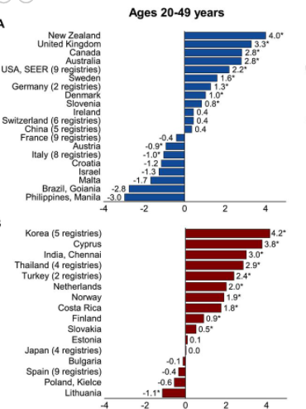
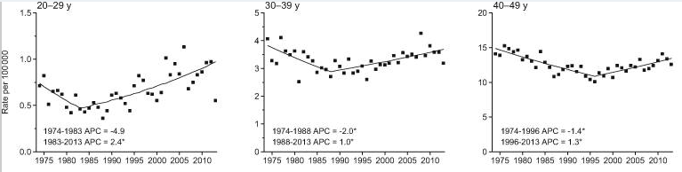
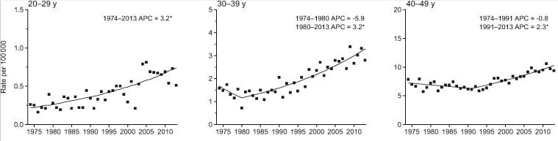
The incidence of colorectal cancer (CRC) in people under 50 years old is increasing without a clear established cause
Colon Cancer
Rectal Cancer
Siegel et al, J Natl Cancer Inst. 2017
Siegel et al, GUT 2019

Slide 3
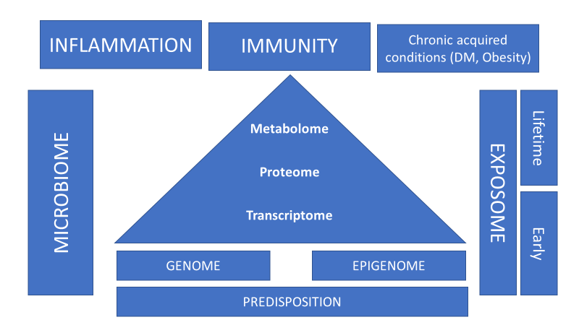

Slide 4

EOCRC. Diagnostic evaluation of CRC predisposition.
Pearlman R et al. JAMA Oncol, 2017

Slide 5
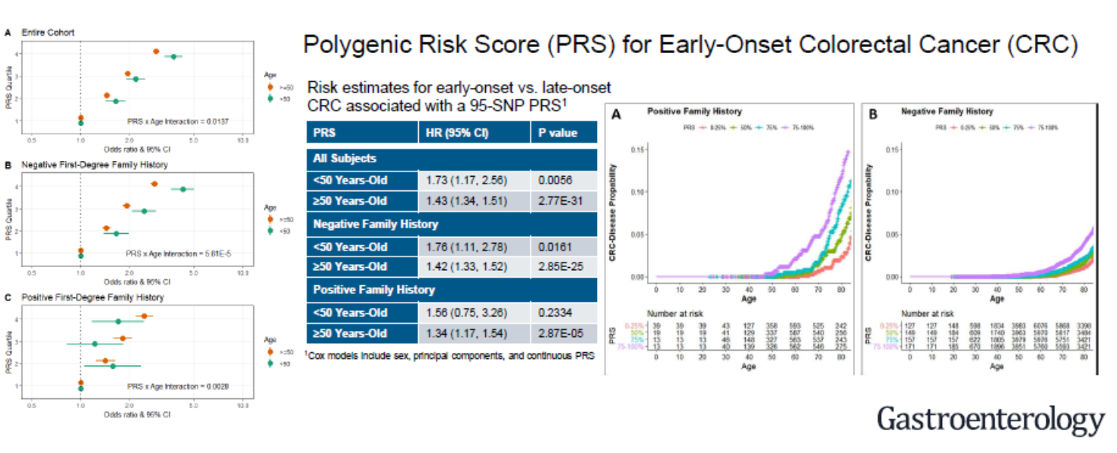
EOCRC. Risk factors.
Archambaum AN et al. Gastroenterol 2020

Slide 6

EOCRC. Risk factors.
  FAMILIAL COLORECTAL CANCER HISTORY.
  OBESITY AND MELLITUS DIABETES (TYPE 2).
  HYPERTRIGLYCERIDEMIA.
  METABOLIC SYNDROME.
  ALCOHOL AND SMOKING.
  MALE.
  SEDENTARY LIFE.

Slide 7
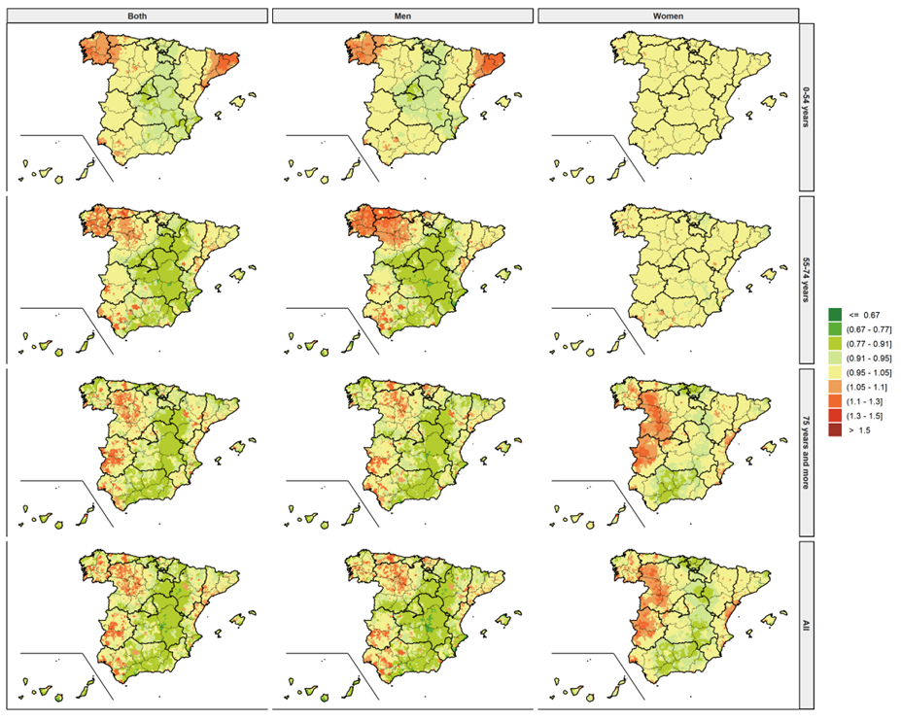
EOCRC. Sex and geographical disparities.
Perea J et al. JAMA Network Open, Under review.
Notes:
Points to undeline regarding EOCRC, and with future impact in EOCRC research.

Slide 8
  SCREENING FOCUSED ON RISK FACTORS
Notes:
Points to undeline regarding EOCRC, and with future impact in EOCRC research.

Slide 9
EOCRC. Diagnostic evaluation of CRC predisposition.
Pearlman R et al. JAMA Oncol, 2017

Slide 10
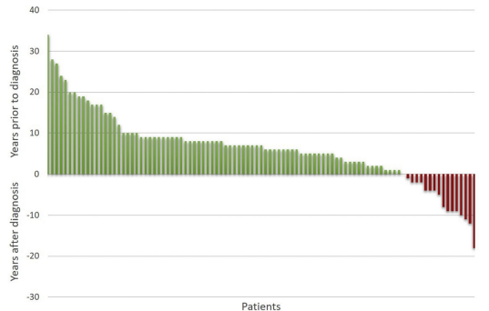
EOCRC. Disparities in screening and prevention.
The component potentially preventable by early screening for FH in early-onset CRC is still uncertain, and a recent study conducted in the US suggests that up to 16% of cases could be prevented if current US screening guidelines were followed.
Potentially prevented:
colonoscopy performed >5 years earlier
Early diagnosis:
Colonoscopy performed >1 year earlier
45 % Potentially preventable
53.6 % Early diagnosis
We sought to explore the proportion of preventable EOCRC due to FH following the ESGE guidelines
Stanich et al, Gastroenterology 2021;160:1850–1852

Slide 11
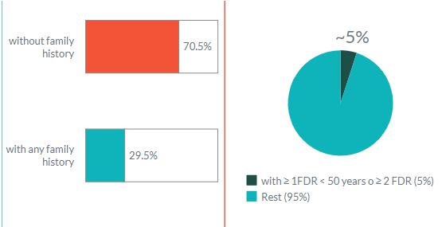
EOCRC. Disparities in screening and prevention.
 | Total (%) | Mean age of CCR
Total | 846 (100%) | 41.7 (±6.56)
Gender (Female/Male) | 403(47.6%)/443(52.4%)
Family History | 250(29.5%) | 41.2 (±2.12)
≥ 1 FDR | 131(15.4%) | 59.6 (±13.2)
≥ 1 FDR < 50 years | 25 (2.9%) | 38.9 (±9.7)
≥ 2 FDR | 16 (1.9%) | 43.25(± 14.4)
≥ 1 FDR < 50 years or ≥ 2 FDR | 39 (4.6%) | 40.45 (±7.01)
Daca MA et al. Gastroenterology. Under review.

Slide 12

SCREENING
75%

Slide 13
Exposome analysis
Hofseth LJ et al. Nat Rev Gastroenterol Hepatol 2020

Slide 14
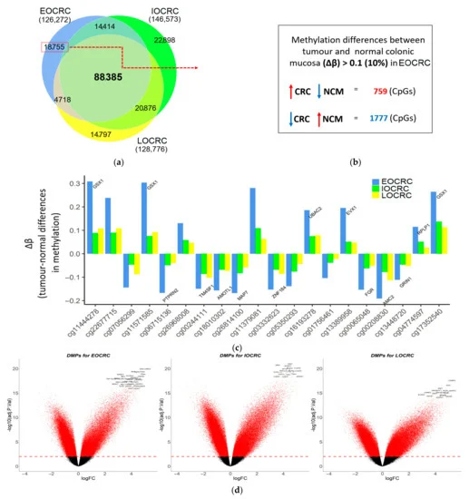
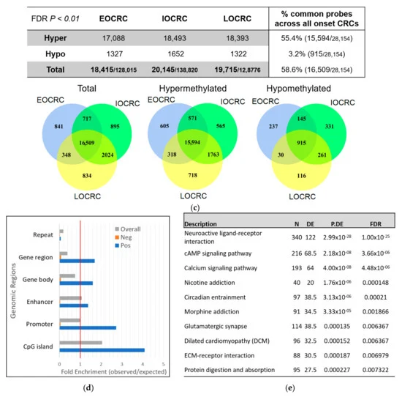
Methylome analysis
Joo JE et al. Cancers 2021
Notes:
EOCRC acquires unique DNAm alterations at 234 loci. CpGs associated with ageing-associated drift were widely affected in EOCRC without needing the decades-long accrual of DNAm drift as commonly seen in intermediate- and late-onset CRCs. Accelerated ageing in normal mucosa from people with EOCRC potentially underlies the earlier age of diagnosis in CRC carcinogenesis

Slide 15
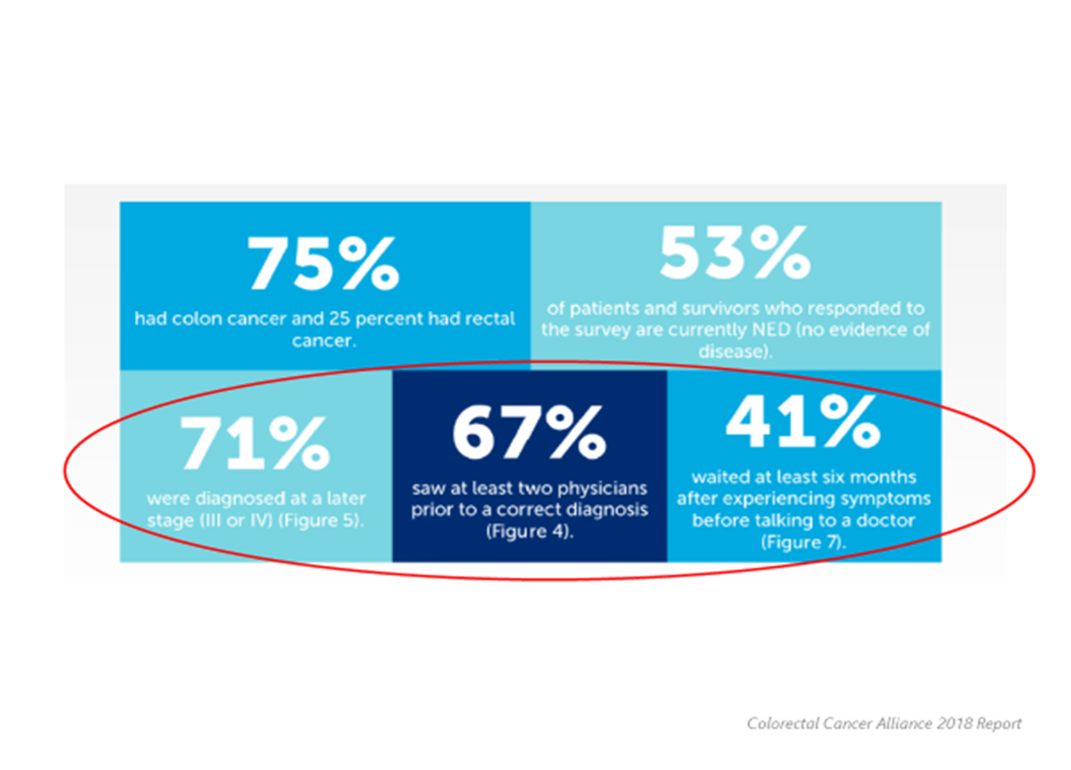

Slide 16
PERSONALISED SCREENING

